Slide 1
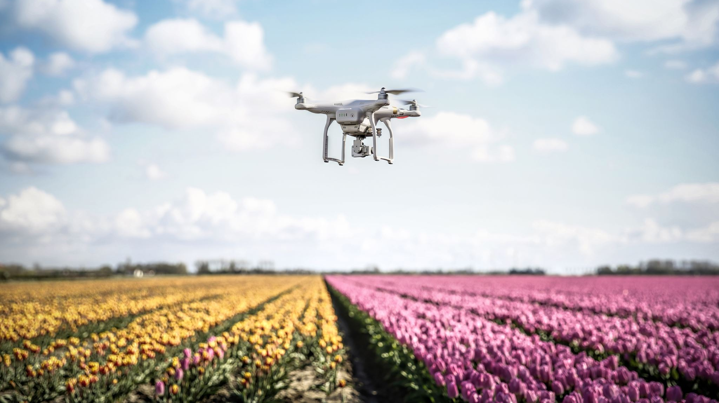
Implementing Drone Delivery System in Swiggy
Deepanshu Bisht
02/04/23

Slide 2
What is Drone Delivery System
Drone delivery is a new way to deliver products to consumers. Instead of focusing on traditional delivery methods – delivery by bicycle or motorbike.
Under this method, orders are prepared and attached to the drones, and then they fly in the sky somewhere between 150 and 300 feet, with Central Government and the concerned Air Traffic Control (ATC) approval, to deliver to consumers.
The drones are autonomous with GPS & Visual sensing to navigate and have 3 direction obstacle sensing.
In most cases, drone pilots oversee all the operations to ensure everything goes accordingly.

Slide 3
Current Delivery Model and its Challenges
Pioneers: Swiggy, Zomato, and Food Panda – complete real- time platforms
From “Hunger Saviors” to “Convenience Enablers”
Works on 3- fold model: Consumers, Restaurants, and Delivery Executives
Inefficiency to cope with volumes
Competition with the Biggies and contemporaries
Dilemma over Logistics

Slide 4
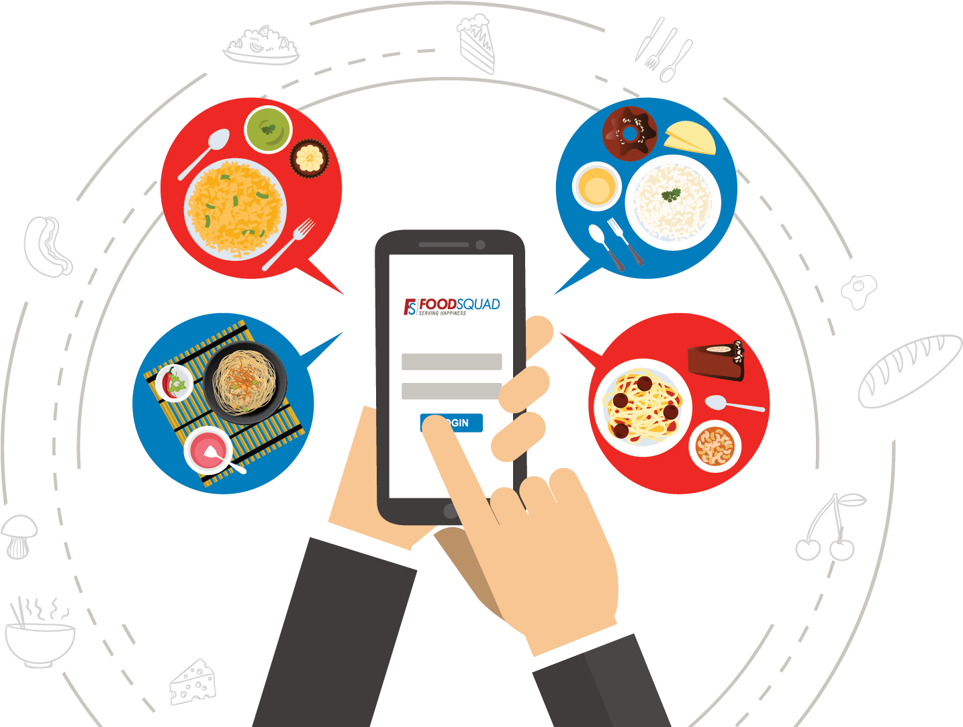

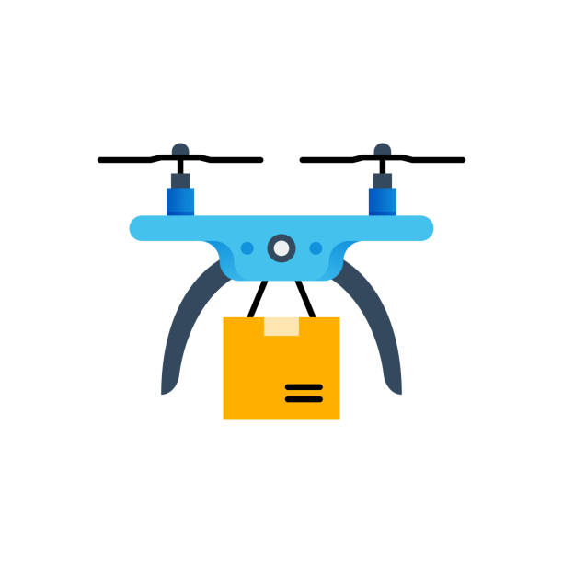

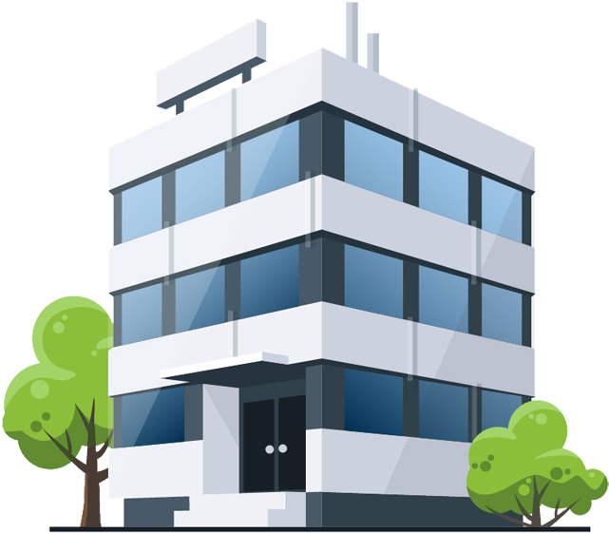
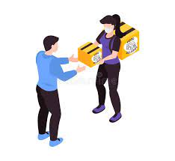
Supply Chain
Customer Orders Food
Food is prepared
Delivery Executive picks up the order from the restaurant
Order arrives at the closest hub from the restaurant
Drone Dispatched from the hub
Order arrives at the closest hub from the customer’s house
Delivery Executive picks the order from the hub
Food is delivered to the customer by the delivery executive

Slide 5
Process
Drone distribution to the areas with high traffic or to remote area.
Drones will be placed in pods that are designated for a particular area's restaurants.
After the customer has placed the order, the order will be sent to the restaurant and a drone will be assigned to the restaurant and the customer.
The customer will receive the tracking information of order.
The details of the restaurant and the area of the customer will be shared with the ground support team who is handling the drone.
When the food is ready, a delivery partner will take the order to a nearby pod, from where the drone will pick up the food and through a designated path, deliver it to the pod i.e. near the customer's area.
Here, another delivery partner will collect the package from pod and deliver it to the customer’s doorstep.

Slide 6
Flowchart
Swiggy
order
order
Customer
Restaurant
Delivery Executive 2
Delivery Executive 1
Swiggy Pod 2
Swiggy Pod 1
Drone

Slide 7
Food Delivery Timeline
ASSUMING 30–40 MINUTES TOTAL ORDER TIME, evenly distributed between preparation and delivery: • 50% time will be taken to prepare, pack and dispatch the food 15min • 50% for transit, finding address and delivering it. 15min • Plus, a buffer for traffic conditions and other unexpected events. 10min
The delivery executive collects the order from the restaurant and drops it to the nearby Swiggy Pod from where the order is sent to the next Swiggy pod nearest to the customer area. Another delivery executive picks the order from there and delivers to the customer.
Drones eliminate the waiting and idle time of the rider.

Slide 8
Requirements
It is recommended to add a warehouse/pod in the area near a group of restaurants to house the drone and provide necessary support system for it to function properly.
Warehouses/pods should be located near high-traffic residential areas or remote areas.
A few delivery executives need to be assigned to the pods near the residential areas and restaurant for delivery of the package.
Drone specialists will be required for both pods.
Customer order tracking should include drone tracking and partner tracking, so customers have a clear view of their orders

Slide 9
Possible Challenges
Legislative and regulatory issues
Talent availability for scaled operations
High Infrastructure setup cost
Public acceptance
Weather impact
Drone abuse
Notes:
To keep a check on issues like altitude (drones cannot fly higher than 400 ft.), span of operation, the weight of the drone, privacy laws, navigable airspace.
There is limited availability of skilled and experienced resources in the drone delivery space.
The initial implementation and set-up costs are high for drones. Setting up of drone launch pads, aligning the movement of drones with buildings and open operational spaces, licenses, battery charging facilities, software and technology, training facility, and research and development require high investments.
Many consumers are still not ready to accept drone deliveries due to privacy, safety, and security concerns.
Efficient drone delivery operations are dependent on weather conditions like rain, wind, snow, etc.
There are chances of theft of packages and potential damage to the drone equipment.

Slide 10
Benefits
Faster air deliveries using shorter and direct routes, saves time for companies.
It is easier to reach remote areas using drones for deliveries can reduce the amount of labor and overhead costs associated with human food delivery.

